Slide 1
SMTB DoD Live
Welcome to SMTB DoD Live. This presentation will provide you with a brief overview of this website along with specifics on upcoming course at SMTB.
All information provided on this site is open to the general public and requires no authentication. Many of the site links will take you to secure sites that require CAC authentication.
If you have any questions regarding information on this site, or access to site links, send an email to address below
NG Camp Robinson NGB ARNG PEC Mailbox ARNG-PEC-SMT-OPNS

Slide 2
SMTB DoD Live
By placing your mouse over "Courses" as shown by the Red Box, a course list will drop down as shown on the next slide.

Slide 3
SMTB DoD Live
In the Courses list, you will see all the upcoming courses for SMTB. Select the course you will be attending, to view course requirements and general information pertaining that course.

Slide 4
SMTB DoD Live
Click on “SMTB Welcome Letter" to get to the PDF Welcome Letter that can be used for DTS.
*Note: There is no LOA for SMTB courses as they are not centrally funded.

Slide 5
SMTB DoD Live
Click on “SMTB Student Guide” for information about Directions To Camp Robinson's Main Gate, Contact Information, Mailing Address/Arrival/Reporting and Departure Procedures, Spouses/Guest, Messages, Medical Care, Billeting/Housekeeping, Dining Facility, Fitness Center, Weapons, Emergency, Financial Matters, Judge Advocacy General (JAG), Rental Cars, Privately Owned Vehicles (POV), Identification, Safety, Classroom Conduct, Fraternization, Required Items, Leave/Pass Policy, PEC Campus Map, and Packing list on page 15.

Slide 6
SMTB DoD Live
Click on “SMTB Course Requirements” for guidance on Waivers and to view common requirements for all SMTB Courses.

Slide 7
SMTB DoD Live
Links in the class menu and on the front page of the DoD Live site will take you the SMTB SharePoint. The next few slides will show you how to upload your documents to SharePoint.
Note: URNCO students and RSP students without an Army 365 account will load their documents in Blackboard.

Slide 8
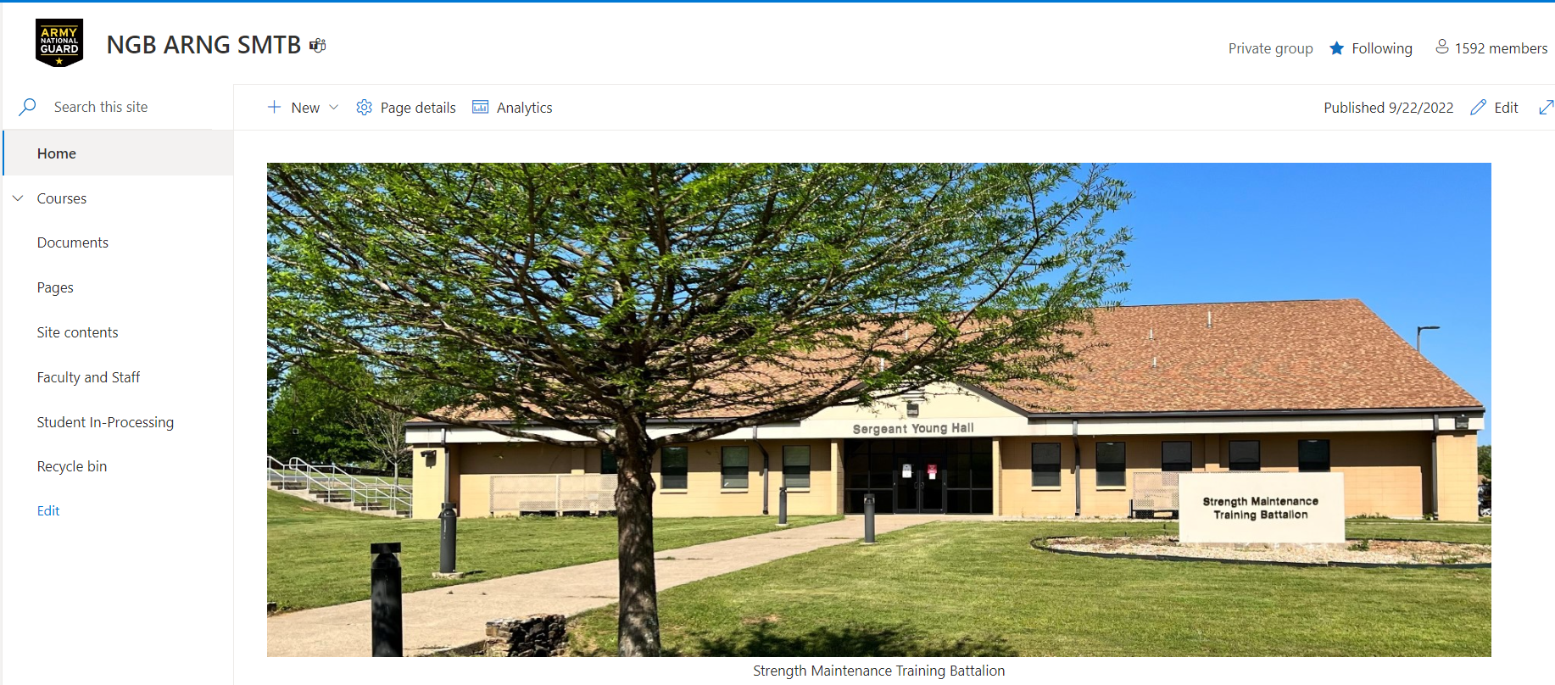
SMTB SharePoint
In SharePoint, click on “Student In-Processing” to the left.

Slide 9
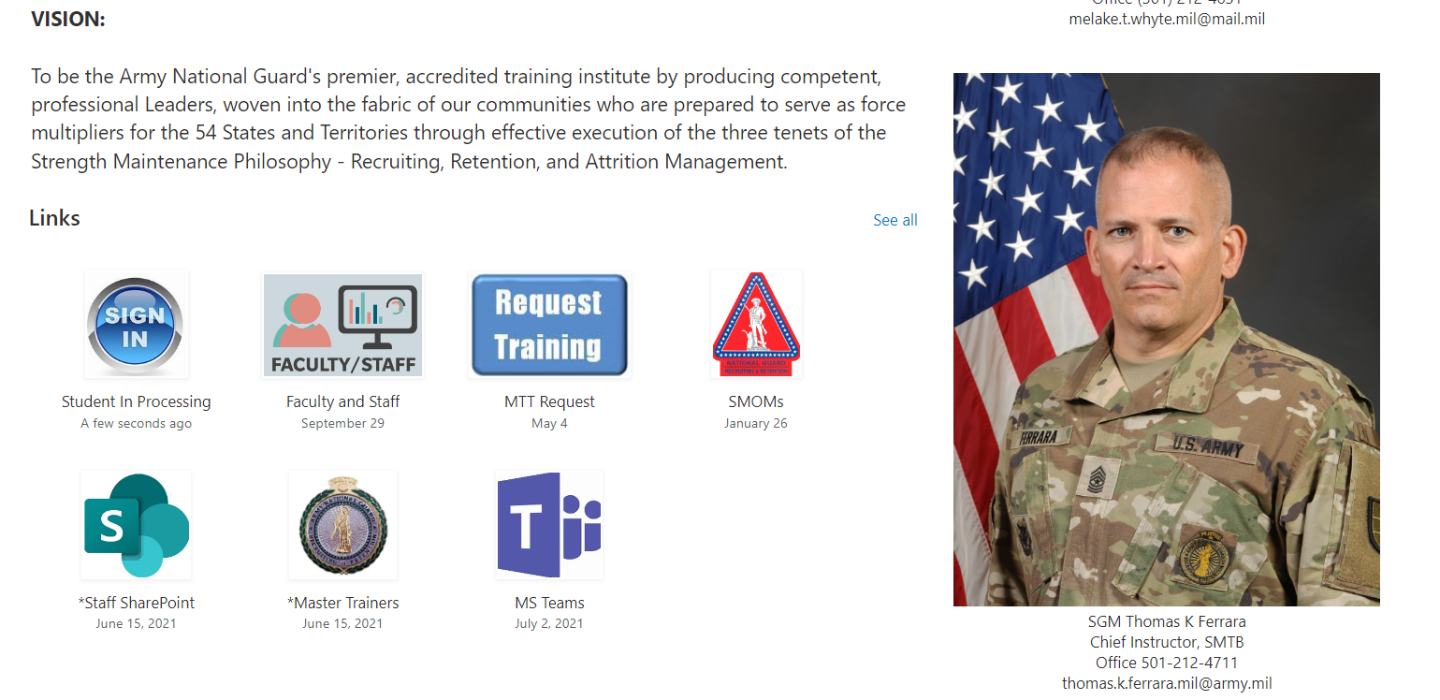
SMTB SharePoint
Or click on “Student In-Processing” under Links.

Slide 10
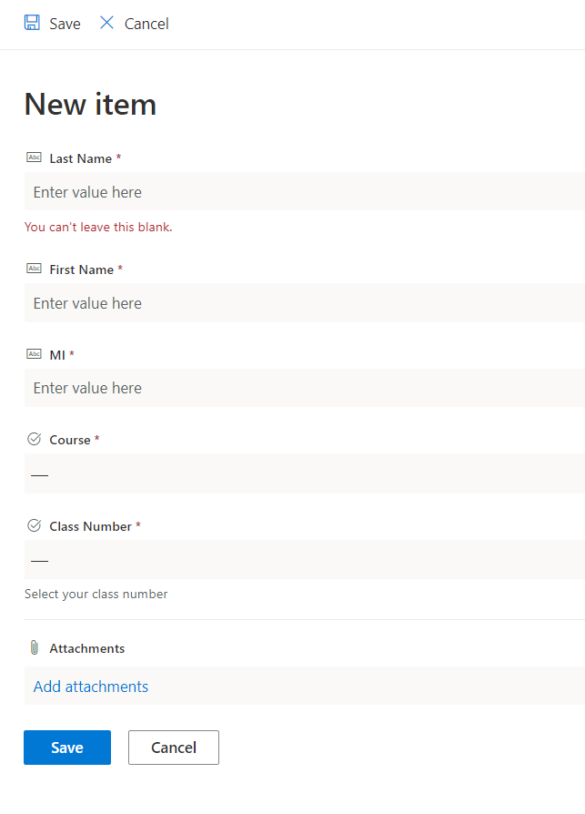
SMTB SharePoint
To upload your documents, click on a new item as shown by the arrow. Then fill in all the information in the box to the right. You can attach multiple documents at one time.
Note: To avoid documents being marked as not submitted, please ensure you are selecting the correct Course and Class Number, otherwise your documents will be uploaded into the wrong folder.
* If you are uploading the same document multiple times, it is important that you include the number of the submission after the naming convention. If the document is uploaded with the same exact name, the system will not overwrite the document with the newest version submitted.*
If you are a NCR (SQI4) student, please upload your documents under course: NCR (SQI4) and NOT under course: RLC

Slide 11
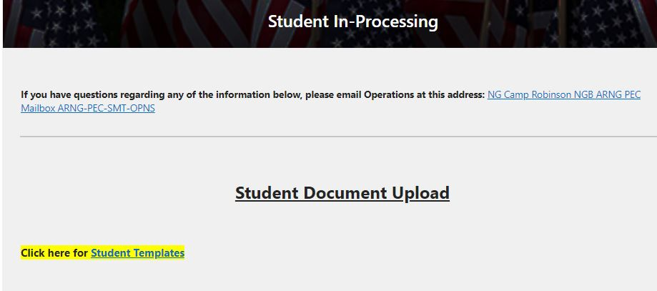
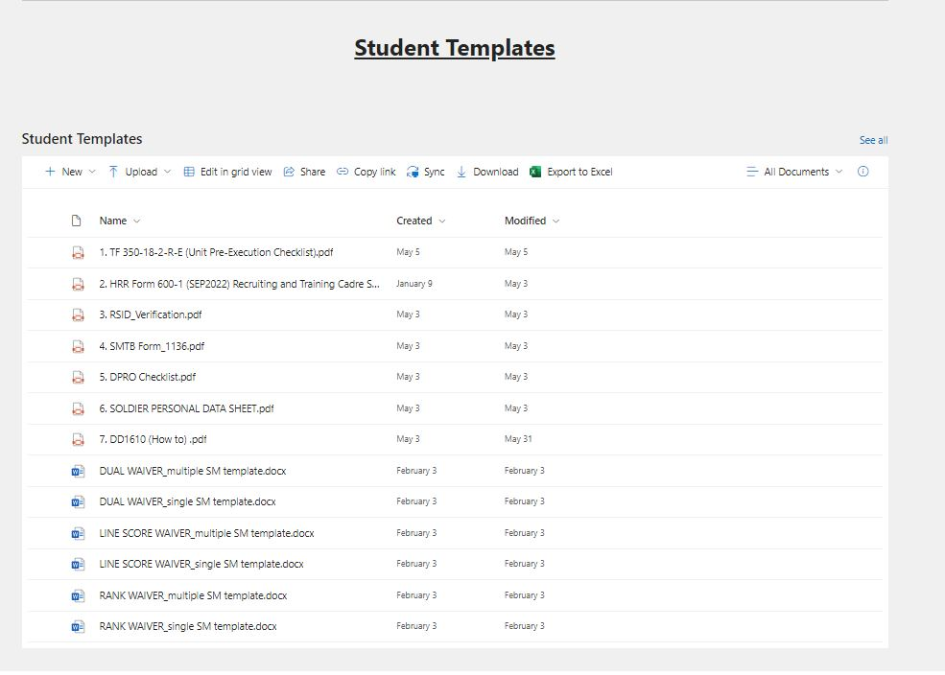
SMTB SharePoint
Click on “Student Templates” located on SharePoint Student In-Processing site to get to templates.
OR
Scroll all the way to the bottom of the SharePoint Student In-Processing site to get to “Student Templates”.

Slide 12
Recruiter Workstations
All Recruiting and Retention Battalion (RRB) personnel attending SMTB courses will utilize their State issued Recruiter Workstation (RWS) - That would be either an RCAS or Accession Baseline System (ABS) Computer.
RRB personnel attending SMTB course must have an appropriate RSID and a functional and compliant RWS. The State RWS will be utilized both in the classroom and for homework assignments.
Failure to have a State RWS will result in the student not being allowed to attend the course. In the event a computer becomes non-compliant or requires maintenance while at SMTB, our IT Section will temporarily issue a student RWS. Our IT staff will reach out to the State Automation NCO and will assist with repairs or remediation as needed.

Slide 13
Sample Welcome Letters
ALCON, Congratulations on your selection in attending your course at the Strength Maintenance Training Battalion (SMTB) at the Professional Education Center (PEC) located at Camp Robinson in Little Rock, Arkansas. Our mission is to provide professional military education that develops capable, adaptable, and disciplined leaders that are prepared to meet the challenges of a dynamic operational environment. Please follow the SMTB DOD Live link listed below. This link will provide you with instructions on uploading required documents and information that will prepare you for your arrival.
A formal welcome letter is available on the SMTB DOD Live site under the Courses tab. You will also find a Student Guide at that location that provides a packing list.
All waivers will be submitted thru Student Document Upload in SharePoint. Waivers must be submitted 10 business days prior to the start date of your course. SMTB DOD Live: https://smtc.dodlive.mil/ SMTB Operations: NG Camp Robinson NGB ARNG PEC Mailbox ARNG-PEC-SMT-OPNS We look forward to seeing you soon!

